Slide 1
Value of the Week:
Warrior Like Mentality
Warriors are those who are engaged in or experienced in battle. One who is engaged aggressively or energetically in an activity, cause, or conflict. Warriors are fighting for something bigger than themselves.
Having a warrior like mentality gives us an edge to go beyond the expected, dig deeper for more information, and rise above distractions that get in the way of the battle.
This warrior like mentality sets up apart from our competitors and drives us to getting the best outcomes for our clients.

Slide 2
Week 2 – Warrior Like Mentality
Warrior like mentality gives us an edge when fighting for our clients.. Ask one more question, dig a little deeper for that missing piece of the pie, and don’t take no for an answer. Warriors do not let their skills weaken - they work daily to make their skills better..

Slide 3
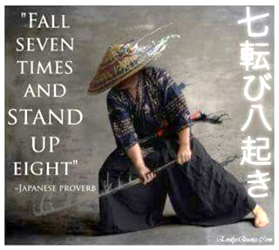

Slide 4
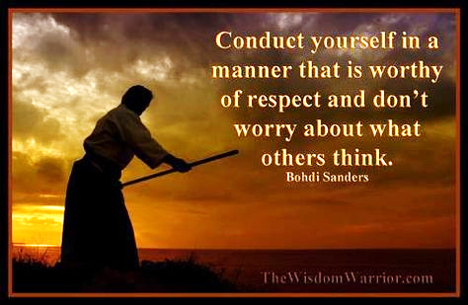

Slide 5
